Slide 1
Problem Statement
In today’s data-driven world, organizations are inundated with vast amount of structured data. This data is rich in information but often remains underutilized due to the complexity of extracting meaningful insights. The challenge lies in effective representation of this Knowledge and generation on actionable insights that can aid in strategic decision making. Traditional methods of data analysis often fall short in handling the dynamic and multifaceted (many aspects) nature of datasets. Hence, there is a pressing need for an advanced AI-based solution that can seamlessly analyze, process and interpret structured data to provide valuable insights.
KEY WORDS: structured data, Data processing, Data analysis, Meaningful Insights , Data visualization, Knowledge Representation.

Slide 2
Unique Idea Brief (Solution)
The primary objective of this project is to develop an AI-based solution capable of analyzing and processing structured datasets to generate meaningful insights. This solution aims to bridge the gap between raw data and actionable knowledge by leveraging the advanced algorithms and techniques. We have chosen a student dataset from Kaggle which is a csv file. We found the student performance by effectively representing knowledge via data visualization and graph-based methods, and employing sophisticated pattern identification techniques, the project seeks to enhance decision-making processes. Finally, the goal is to create a robust system that empowers users to gain deeper understanding and insightful information from their data, thereby driving more informed and strategic decisions.

Slide 3
Features Offered
Data Ingestion:
Ability to upload and process datasets from CSV files.
Automated data pipeline to handle data ingestion efficiently.
Data Preprocessing:
Handling Missing Values: Detection and treatment of missing values using techniques such as filling with suitable values or removing rows/columns.
Duplicate Removal: Identification and elimination of duplicate rows to ensure data quality.
Data Analysis:
Pandas Profiling: Generation of comprehensive reports including summary statistics, histograms, density plots, correlation matrices, and heatmaps.
Statistical Analysis: Calculation of basic statistics like mean, median, and mode for each column.
Pattern Identification:
Clustering: Implementation of K-Means clustering to group similar data points and identify inherent structures and segmentations within the dataset.
Cluster Analysis: Display of cluster labels and centroids to understand the grouping of data points.
Visualization:
Data Visualization Techniques: Use of bar charts, scatter plots, heat maps, histograms, and more advanced visualizations like interactive dashboards to present data insights effectively.

Slide 4
Process flow
Data Cleaning: Ensuring data quality by removing duplicates and handling missing values.
Handling Missing Values: Using methods like df.isnull() to detect and address missing data.
Duplicate Removal: Identifying and removing duplicate rows to ensure the integrity of the dataset.
Data Analysis:
Pandas Profiling: Generating comprehensive reports that include summary statistics, histograms, density plots, correlation matrices, and heatmaps.
Statistical Analysis: Performing basic statistical analysis to calculate mean, median, mode, and other relevant statistics for each column.
K-Means Clustering: Applying the K-Means algorithm to group similar data points, identifying inherent structures and segmentations within the dataset.
Visualization and Reporting:
Data Visualization: Using bar charts, scatter plots, heat maps, histograms, and interactive dashboards to effectively present data insights.
Cluster Visualization: Creating scatter plots to visualize clustering results, with each data point colored according to its cluster label.
Comprehensive Reports: Generating detailed reports using tools like Pandas Profiling to provide a thorough understanding of the dataset.

Slide 5
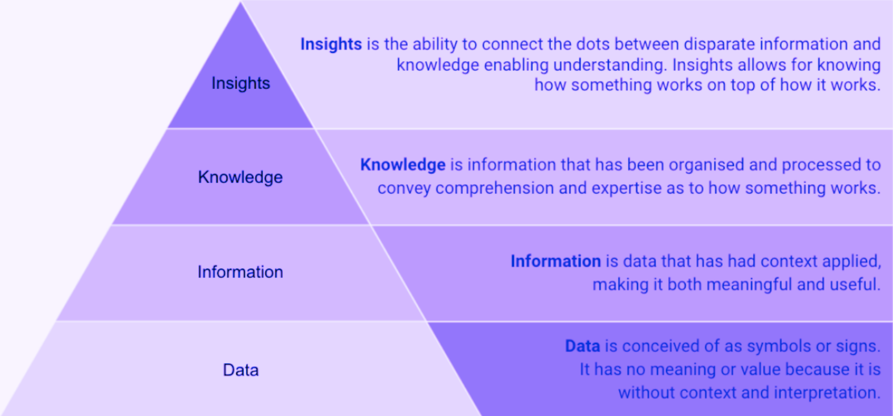
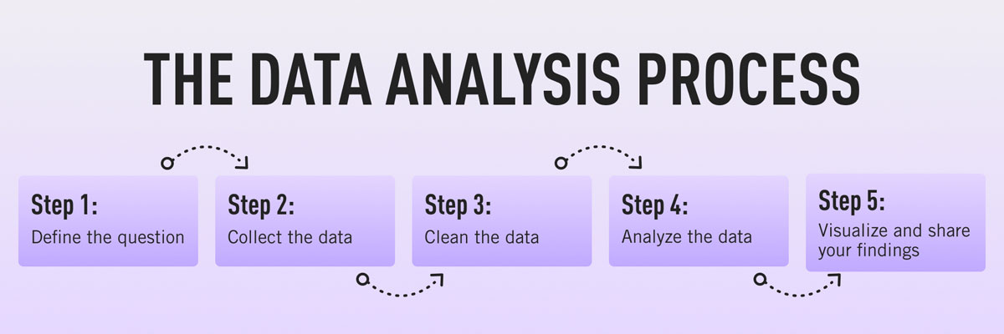
Architecture Diagram

Slide 6
Technologies used
Python
Python is the primary language for data analysis and ML due to its extensive libraries:
Pandas: For data manipulation and analysis with structures like DataFrames and Series.
NumPy: For scientific computing, supporting arrays, matrices, and various mathematical functions.
Scikit-Learn: For machine learning, offering tools for classification, regression, and clustering.
Additional Libraries
ydata_profiling: Generates comprehensive profile reports for pandas DataFrames.
Matplotlib: Creates scatter plots and other visualizations for clustering results.
Streamlit: Used for web interfacing, creating interactive web applications with functions like set_page_config, title, markdown, expander, code, sidebar, write, header, DataFrame, altair_chart, and warning.
These tools create a comprehensive system for data representation, insight generation, and strategic decision-making.

Slide 7
Team members and contribution:
PREETHI Roll no: 22311A6623 CSE-AIML Team lead
(22311A6623@aiml.sreenidhi.edu.in)
VIRAJITHA Roll no: 22311A6619 CSE-AIML Team member
(22311A6617@aiml.sreenidhi.edu.in)
MANIKESH Roll no: 22311A6691 CSE-AIML Team member
(22311A6691@aiml.sreenidhi.edu.in)
VISHAL Roll no: 22311A6690 CSE-AIML Team member
(22311A6690@aiml.sreenidhi.edu.in)
HARINI Roll no: 22311A6667 CSE-AIML Team member
(22311A6667@aiml.sreenidhi.edu.in)

Slide 8
Conclusion
Exploratory Data Analysis: Users can upload data, generate detailed summary reports, and gain insights into the dataset's structure and relationships.
Clustering Analysis: Perform K-Means clustering to uncover patterns, groups, and outliers within the data.
Visualization: Scatter plots provide an intuitive way to understand clustering results and data point distribution.
Future Work
Interactive Chatbot: An integrated chatbot will enhance user experience by answering queries, providing guidance on data analysis, explaining profiling reports, and interpreting clustering results.
History Saving: A feature to save and revisit previous analyses, including datasets, profiling reports, clustering parameters, and results, allowing users to track progress and compare analyses seamlessly.

